Slide 1
Ms. Rhodes
Third Grade Teacher- Union Elementary
Outstanding Woman in Technology

Slide 2
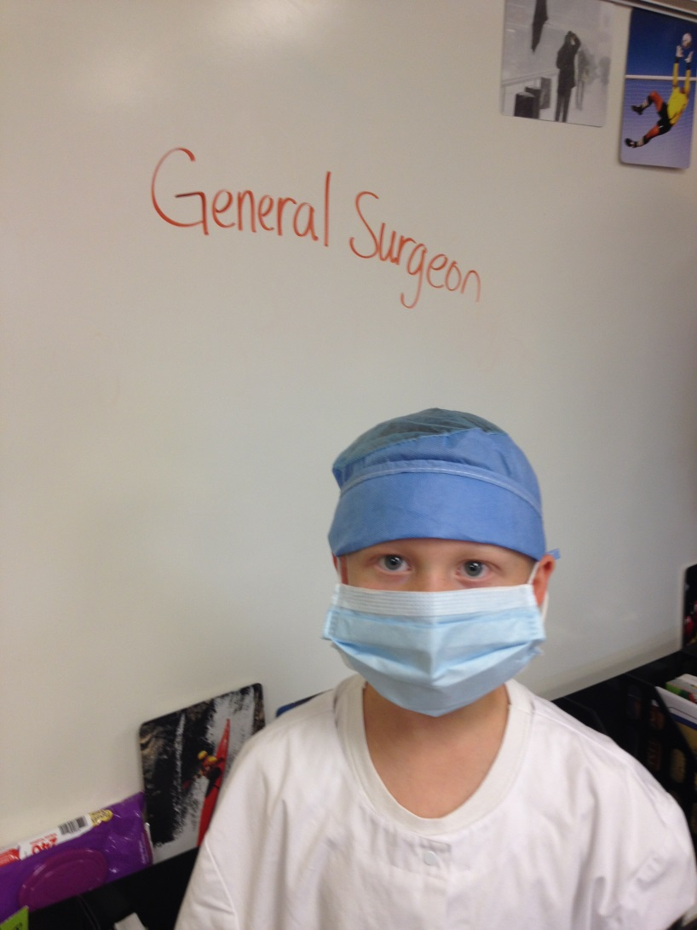
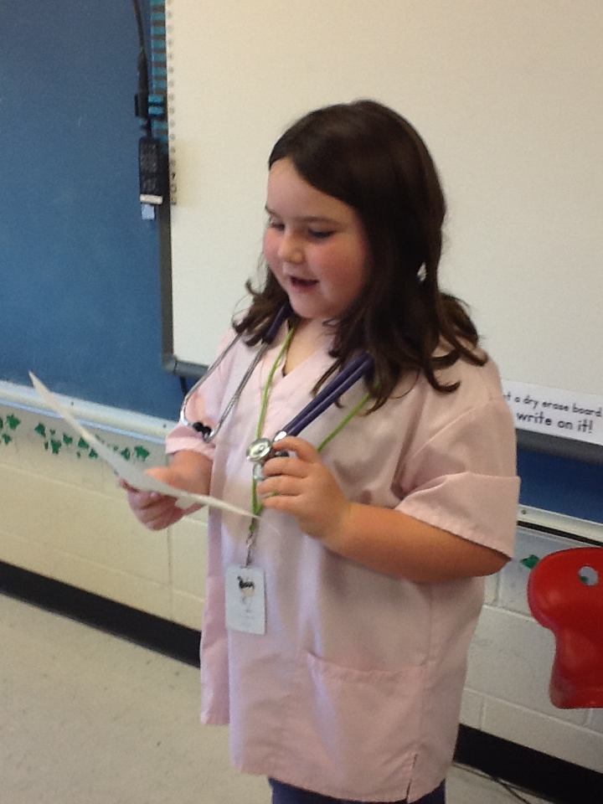
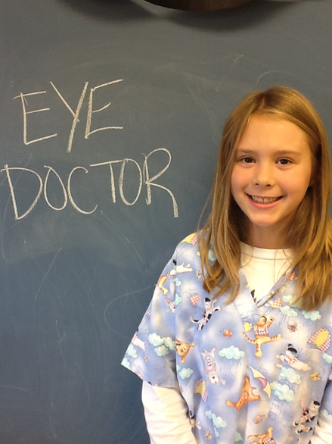
Fall Celebration- student use technology to research a career and then present to their class regarding the career.

Slide 3
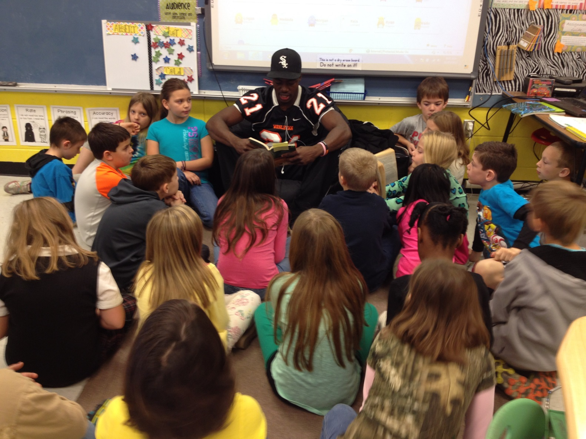
Bobcat Buddy- College students read aloud to students

Slide 4
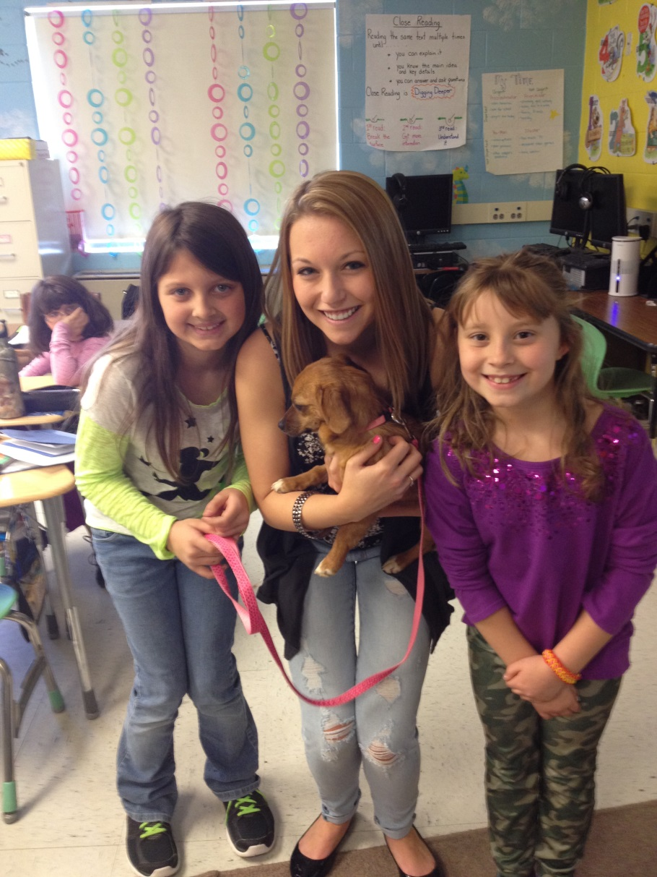
College Service Scholars

Slide 5
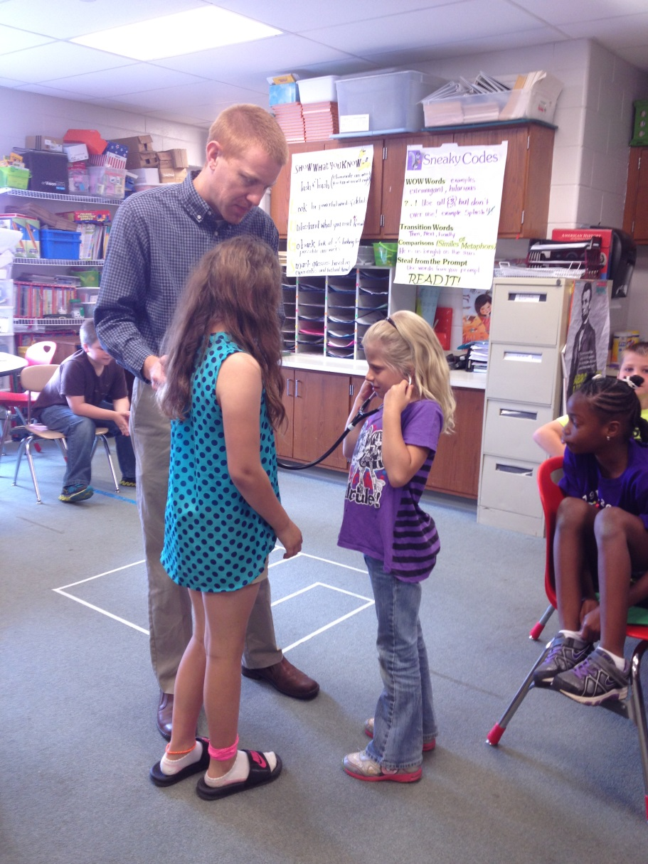
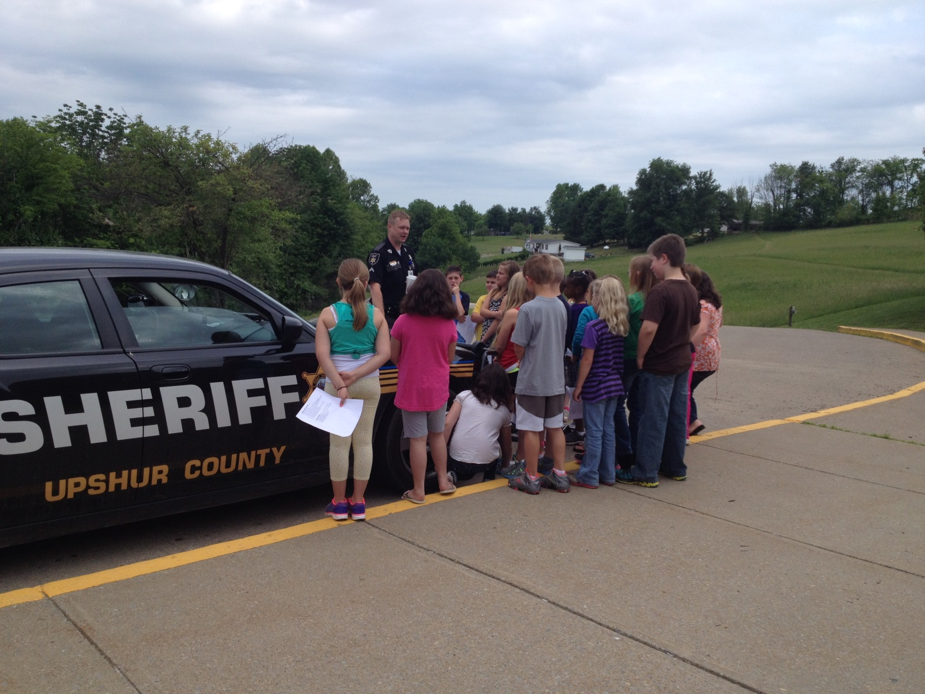
Career Day

Slide 6
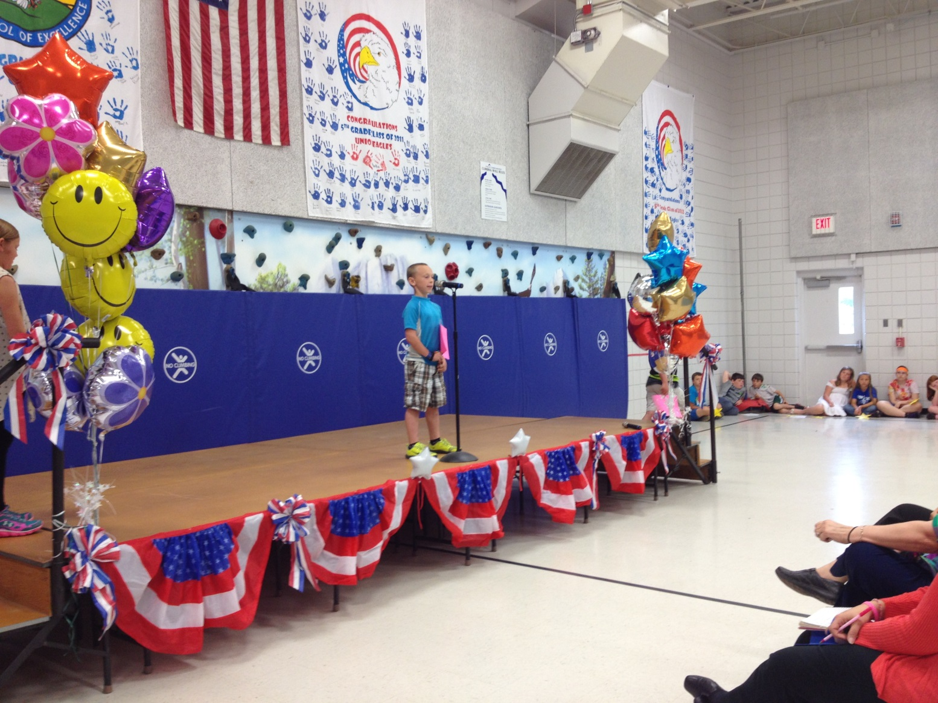
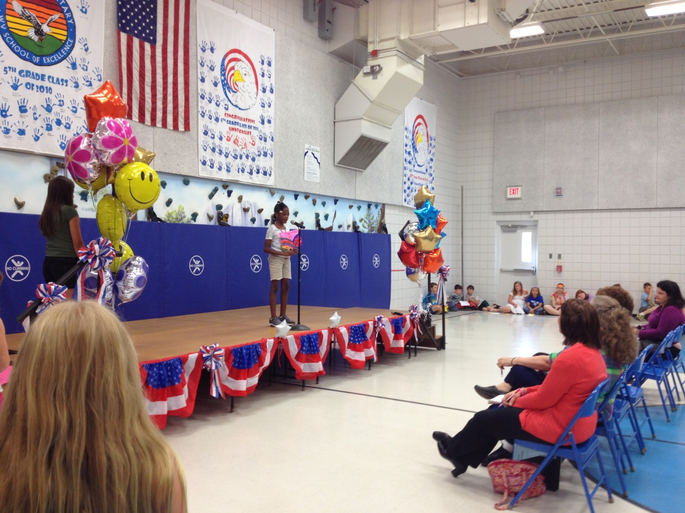
Achievement Parade
Building confidence within students

Slide 7
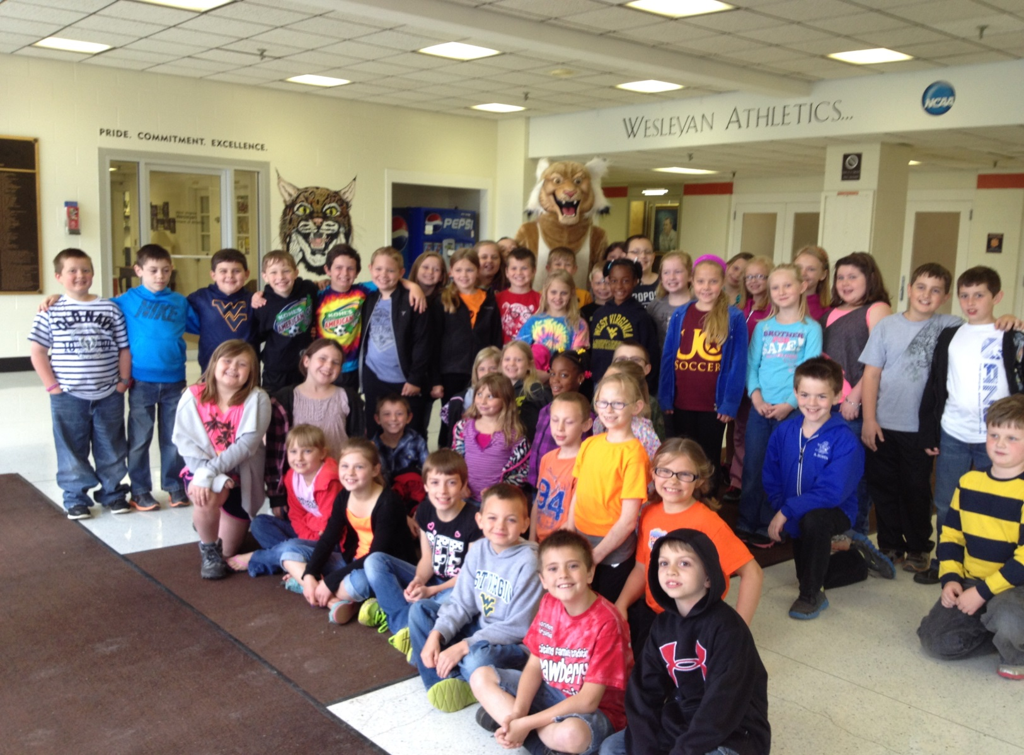
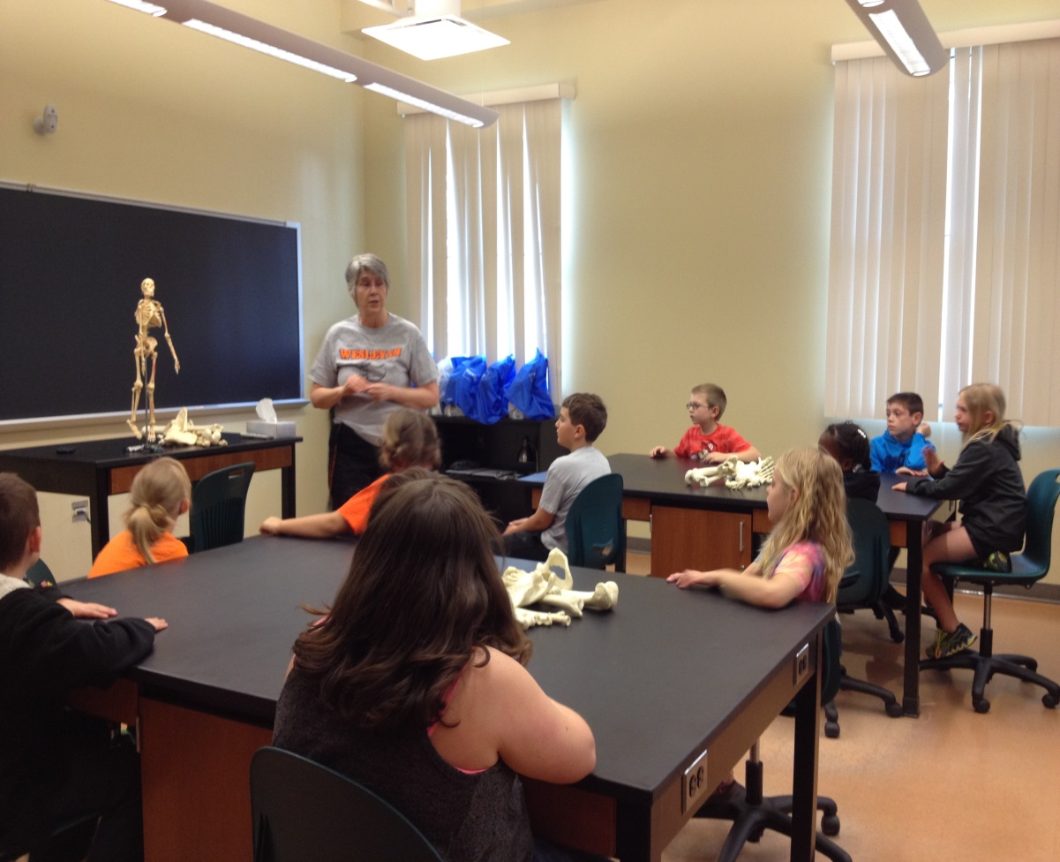
College Visits – West Virginia Wesleyan College

Slide 8
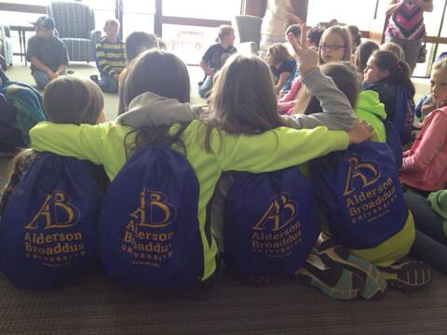
College Visits- Alderson Broaddus University

